Slide 1
A very short introduction to Bayesian Model Building
Mafalda Dias & Jonathan Frazer

Slide 2
MENU
Starters
Bayesian models as generative stories
DAGs
Box’s Loop
Mains
Bayes' rule
A working exercise: coin flipping
Informative Vs uninformative priors
Dessert
Notes on inference: conjugate priors & numerical approaches
Hierarchical models
Bayesian Experimental Design

Slide 3
MENU
Starters
Bayesian models as generative stories
DAGs
Box’s Loop
Mains
Bayes' rule
PART I. A working exercise: coin flipping
Informative Vs uninformative priors
Dessert
Notes on inference: conjugate priors & numerical approaches
PART II. Hierarchical models
PART III. Bayesian Experimental Design

Slide 4
Starters

Slide 5
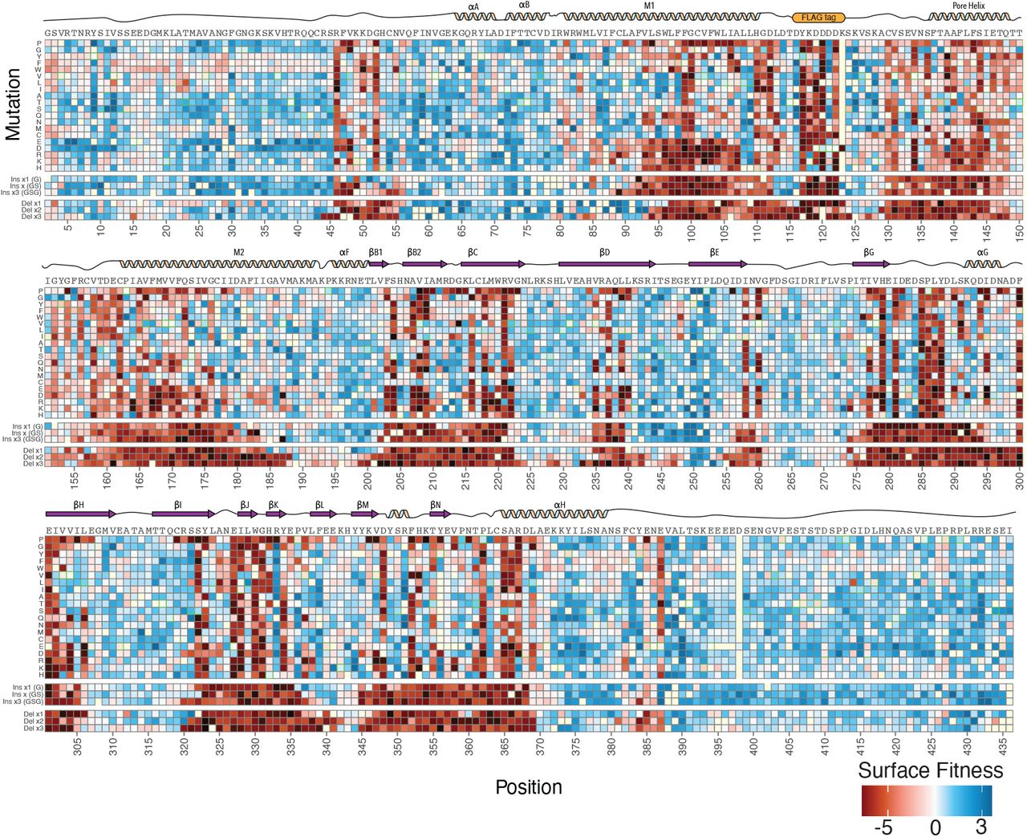
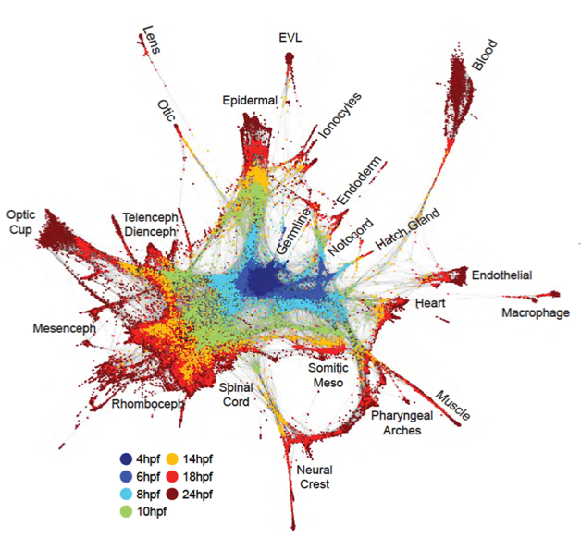
The ever growing need for probabilistic model building in biology
Data getting more quantitative, complex and larger – how to distill this information?
In this course we will introduce you to the beautiful and intimately linked worlds of generative and Bayesian modelling – a framework for:
thinking about beliefs
how they should change as a result of new observations
how to make predictions and decisions in the presence of uncertainty.
MacDonald et al Genome Biology 2023
Wagner, Weinreb et al Science 2018
Notes:
Historically, biologists have learnt a great deal from qualitative studies
Biology in the modern era looks very different for many sub-disciplines
Experiments are generally getting bigger and more complex
As data becomes quantitative, and "bigger" and higher-dimensional, there becomes a need for mathematical techniques that will help us distill this information.
In this course we will introduce you to the beautiful and intimately linked worlds of generative and Bayesian modelling - a very general framework for thinking about beliefs and how they should change as a result of new observations and how to make predictions and decisions in the presence of uncertainty.

Slide 6
Characterising the model rather than the data
Bayesian analysis attempts to characterize the underlying model or distribution, rather than characterizing the observed data.
In contrast, classic approaches can be thought of as a long-term frequency statement, which is a statement about the data specifically.

Slide 7
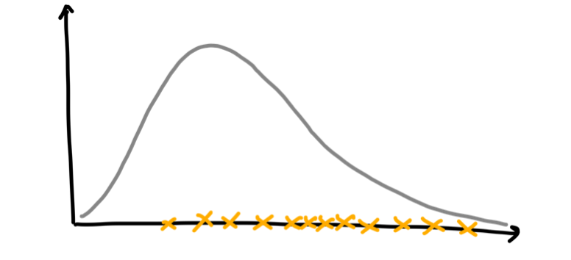
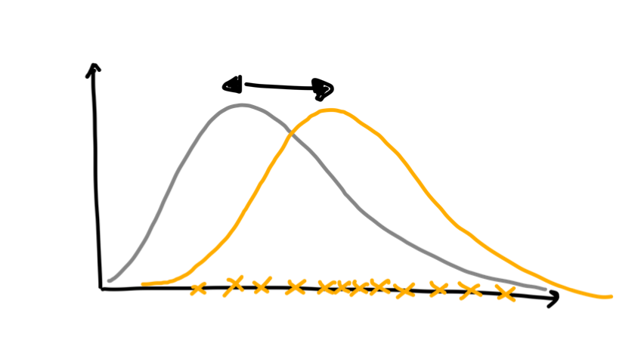
Characterising the model rather than the data
Bayesian analysis attempts to characterize the underlying model or distribution, rather than characterizing the observed data.
In contrast, classic approaches can be thought of as a long-term frequency statement, which is a statement about the data specifically.
Example: Test the significance of an observation against a null-hypothesis.
Classical perspective – Test how unlikely the observation is under the null model.
Bayesian perspective – Model the distribution of the data and test if this model significantly deviates from the null.

Slide 8
Telling Generative Stories
In recent years there has been a lot of hype around generative modelling in the machine learning sense of the term – think text and image generation.
In contemporary applied statistics the emphasis is a bit different. Here, generative modelling refers primarily to a means of interpreting data – the model tells a story of how a given dataset was generated.
Notes:
A directed acyclic graph (DAG) is a graphical representation that is used to model and visualize probabilistic relationships between random variables. They are a handy tool when analysing more complext models as they make explicit the heirarchy of causal dependencies between parameters and which are or are not statistically inepdendent.
A directed acyclic graph consists of nodes and directed edges. In this context:
Nodes: Each node in the graph represents a random variable or a set of random variables. These random variables can be discrete or continuous and may represent various aspects of a system or problem.
Directed Edges: Directed edges between nodes represent conditional dependencies between random variables. An arrow from one node to another indicates that the first variable influences the second variable. In other words, it shows the direction of probabilistic influence. For example, if you have two nodes A and B with an arrow from A to B, it means that the value of A influences the probability distribution of B.
Acyclic: The term "acyclic" means that there are no cycles in the graph, i.e., you cannot follow a sequence of edges and return to the same node by traversing the edges. This acyclic property ensures that the graph does not have feedback loops or recursive dependencies.
Bayesian networks use these directed acyclic graphs to represent and compute probabilistic relationships efficiently. The graphical structure of the DAG encodes conditional independence relationships between random variables. This enables efficient probabilistic inference, such as calculating conditional probabilities, given evidence or making predictions based on the model.

Slide 9
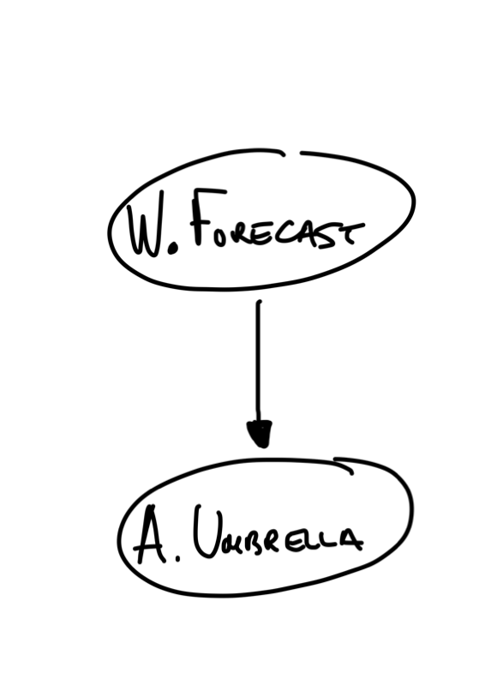
DAG
Directed Acyclical Graph
Telling Generative Stories
In recent years there has been a lot of hype around generative modelling in the machine learning sense of the term – think text and image generation.
In contemporary applied statistics the emphasis is a bit different. Here, generative modelling refers primarily to a means of interpreting data – the model tells a story of how a given dataset was generated.
A nice way to visualise this is via a DAG.
Example: model the likelihood of Alice carrying an umbrella based on weather forecast.
Notes:
A directed acyclic graph (DAG) is a graphical representation that is used to model and visualize probabilistic relationships between random variables. They are a handy tool when analysing more complext models as they make explicit the heirarchy of causal dependencies between parameters and which are or are not statistically inepdendent.
A directed acyclic graph consists of nodes and directed edges. In this context:
Nodes: Each node in the graph represents a random variable or a set of random variables. These random variables can be discrete or continuous and may represent various aspects of a system or problem.
Directed Edges: Directed edges between nodes represent conditional dependencies between random variables. An arrow from one node to another indicates that the first variable influences the second variable. In other words, it shows the direction of probabilistic influence. For example, if you have two nodes A and B with an arrow from A to B, it means that the value of A influences the probability distribution of B.
Acyclic: The term "acyclic" means that there are no cycles in the graph, i.e., you cannot follow a sequence of edges and return to the same node by traversing the edges. This acyclic property ensures that the graph does not have feedback loops or recursive dependencies.
Bayesian networks use these directed acyclic graphs to represent and compute probabilistic relationships efficiently. The graphical structure of the DAG encodes conditional independence relationships between random variables. This enables efficient probabilistic inference, such as calculating conditional probabilities, given evidence or making predictions based on the model.

Slide 10
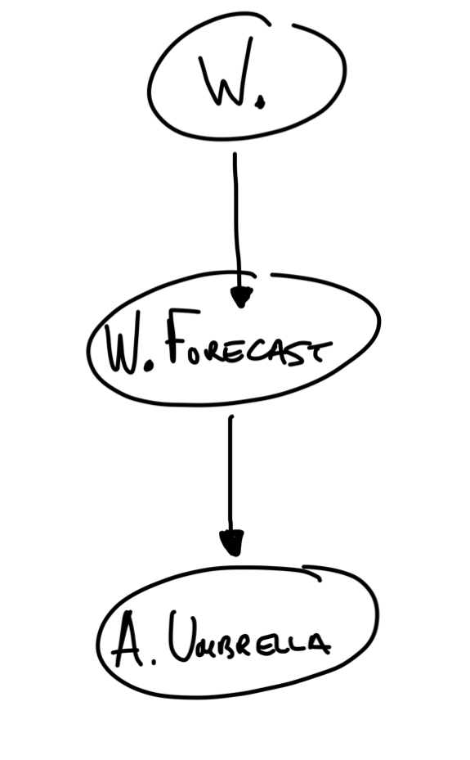
DAG
Directed Acyclical Graph
Telling Generative Stories
In recent years there has been a lot of hype around generative modelling in the machine learning sense of the term – think text and image generation.
In contemporary applied statistics the emphasis is a bit different. Here, generative modelling refers primarily to a means of interpreting data – the model tells a story of how a given dataset was generated.
A nice way to visualise this is via a DAG.
Example: model the likelihood of Alice carrying an umbrella based on weather forecast.
Notes:
A directed acyclic graph (DAG) is a graphical representation that is used to model and visualize probabilistic relationships between random variables. They are a handy tool when analysing more complext models as they make explicit the heirarchy of causal dependencies between parameters and which are or are not statistically inepdendent.
A directed acyclic graph consists of nodes and directed edges. In this context:
Nodes: Each node in the graph represents a random variable or a set of random variables. These random variables can be discrete or continuous and may represent various aspects of a system or problem.
Directed Edges: Directed edges between nodes represent conditional dependencies between random variables. An arrow from one node to another indicates that the first variable influences the second variable. In other words, it shows the direction of probabilistic influence. For example, if you have two nodes A and B with an arrow from A to B, it means that the value of A influences the probability distribution of B.
Acyclic: The term "acyclic" means that there are no cycles in the graph, i.e., you cannot follow a sequence of edges and return to the same node by traversing the edges. This acyclic property ensures that the graph does not have feedback loops or recursive dependencies.
Bayesian networks use these directed acyclic graphs to represent and compute probabilistic relationships efficiently. The graphical structure of the DAG encodes conditional independence relationships between random variables. This enables efficient probabilistic inference, such as calculating conditional probabilities, given evidence or making predictions based on the model.

Slide 11
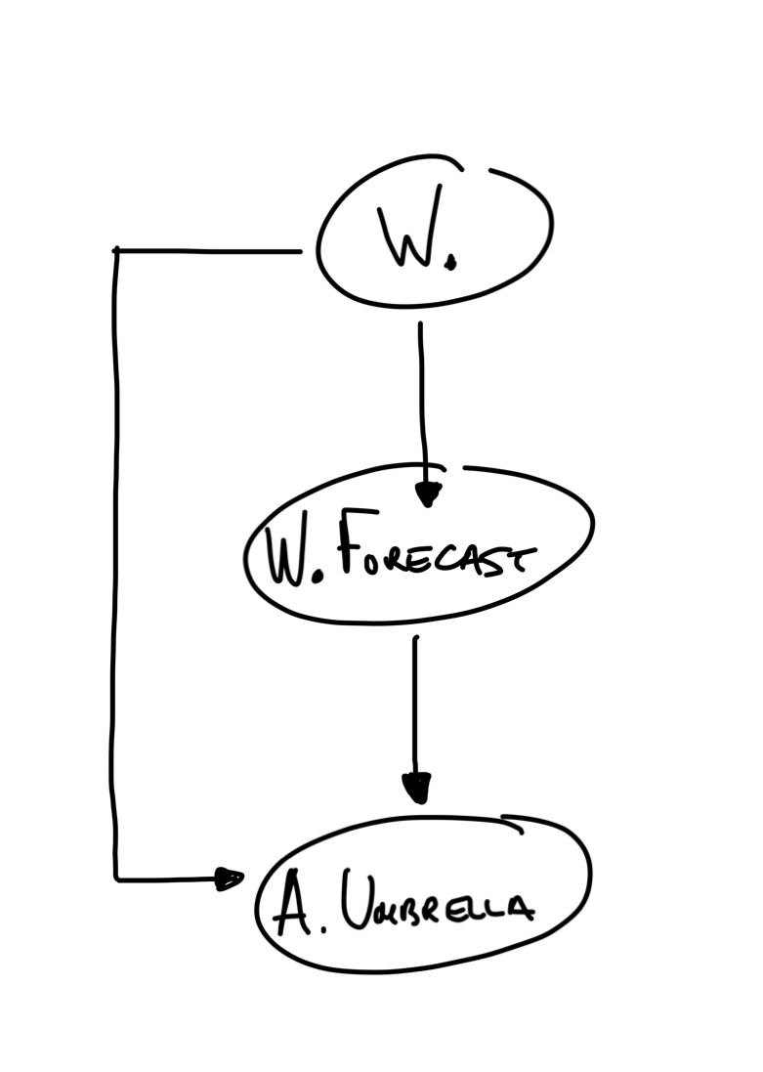
DAG
Directed Acyclical Graph
Telling Generative Stories
In recent years there has been a lot of hype around generative modelling in the machine learning sense of the term – think text and image generation.
In contemporary applied statistics the emphasis is a bit different. Here, generative modelling refers primarily to a means of interpreting data – the model tells a story of how a given dataset was generated.
A nice way to visualise this is via a DAG.
Example: model the likelihood of Alice carrying an umbrella based on weather forecast.
Notes:
A directed acyclic graph (DAG) is a graphical representation that is used to model and visualize probabilistic relationships between random variables. They are a handy tool when analysing more complext models as they make explicit the heirarchy of causal dependencies between parameters and which are or are not statistically inepdendent.
A directed acyclic graph consists of nodes and directed edges. In this context:
Nodes: Each node in the graph represents a random variable or a set of random variables. These random variables can be discrete or continuous and may represent various aspects of a system or problem.
Directed Edges: Directed edges between nodes represent conditional dependencies between random variables. An arrow from one node to another indicates that the first variable influences the second variable. In other words, it shows the direction of probabilistic influence. For example, if you have two nodes A and B with an arrow from A to B, it means that the value of A influences the probability distribution of B.
Acyclic: The term "acyclic" means that there are no cycles in the graph, i.e., you cannot follow a sequence of edges and return to the same node by traversing the edges. This acyclic property ensures that the graph does not have feedback loops or recursive dependencies.
Bayesian networks use these directed acyclic graphs to represent and compute probabilistic relationships efficiently. The graphical structure of the DAG encodes conditional independence relationships between random variables. This enables efficient probabilistic inference, such as calculating conditional probabilities, given evidence or making predictions based on the model.

Slide 12
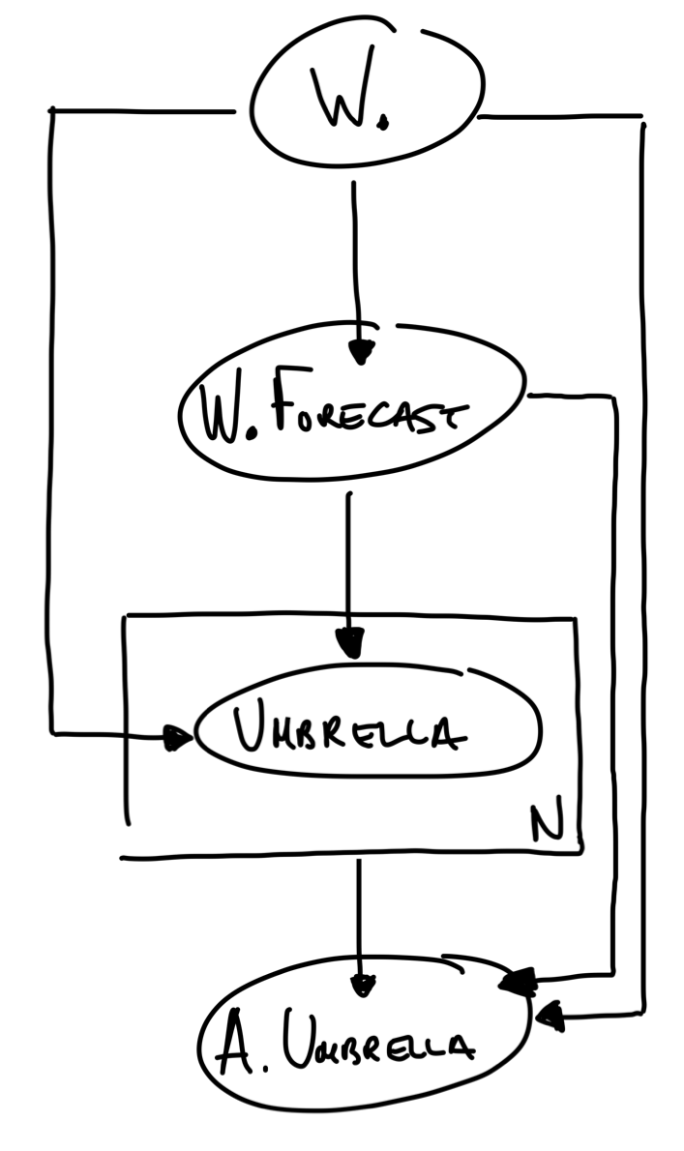
DAG
Directed Acyclical Graph
Telling Generative Stories
In recent years there has been a lot of hype around generative modelling in the machine learning sense of the term – think text and image generation.
In contemporary applied statistics the emphasis is a bit different. Here, generative modelling refers primarily to a means of interpreting data – the model tells a story of how a given dataset was generated.
A nice way to visualise this is via a DAG.
Notes:
A directed acyclic graph (DAG) is a graphical representation that is used to model and visualize probabilistic relationships between random variables. They are a handy tool when analysing more complext models as they make explicit the heirarchy of causal dependencies between parameters and which are or are not statistically inepdendent.
A directed acyclic graph consists of nodes and directed edges. In this context:
Nodes: Each node in the graph represents a random variable or a set of random variables. These random variables can be discrete or continuous and may represent various aspects of a system or problem.
Directed Edges: Directed edges between nodes represent conditional dependencies between random variables. An arrow from one node to another indicates that the first variable influences the second variable. In other words, it shows the direction of probabilistic influence. For example, if you have two nodes A and B with an arrow from A to B, it means that the value of A influences the probability distribution of B.
Acyclic: The term "acyclic" means that there are no cycles in the graph, i.e., you cannot follow a sequence of edges and return to the same node by traversing the edges. This acyclic property ensures that the graph does not have feedback loops or recursive dependencies.
Bayesian networks use these directed acyclic graphs to represent and compute probabilistic relationships efficiently. The graphical structure of the DAG encodes conditional independence relationships between random variables. This enables efficient probabilistic inference, such as calculating conditional probabilities, given evidence or making predictions based on the model.

Slide 13
All models are wrong but some are useful
In practice model building is part art-form and part science.
To make a model you have to make simplifying assumptions. The art is in making simplifying assumptions that preserve key features of reality, thus enabling us to learn something from the model and/or use it for something.
Notes:
Pretty much whenever we design an experiment, or analyse data, and certainly if we make any kind of hypothesis, then implicitly or otherwise, we are building a model. In many situations it is beneficial to make this model as explicit as possible. In doing so it forces us to state our assumptions and enables us to test to what degree our assumptions approximate reality. Often model building will enable us to go much further than this though. If we are able to model our system of interest, then it enables us to make predictions and/or draw other conclusions from our data. If our model fails to match observation it can guide the future direction of our research. This process can be summarised by what is sometimes referred to as Box's loop

Slide 14
All models are wrong but some are useful
In practice model building is part art-form and part science.
To make a model you have to make simplifying assumptions. The art is in making simplifying assumptions that preserve key features of reality, thus enabling us to learn something from the model and/or use it for something.
Pretty much whenever we design an experiment, or analyse data, and certainly if we make any kind of hypothesis, then implicitly or otherwise, we are building a model.
Notes:
Pretty much whenever we design an experiment, or analyse data, and certainly if we make any kind of hypothesis, then implicitly or otherwise, we are building a model. In many situations it is beneficial to make this model as explicit as possible. In doing so it forces us to state our assumptions and enables us to test to what degree our assumptions approximate reality. Often model building will enable us to go much further than this though. If we are able to model our system of interest, then it enables us to make predictions and/or draw other conclusions from our data. If our model fails to match observation it can guide the future direction of our research. This process can be summarised by what is sometimes referred to as Box's loop

Slide 15
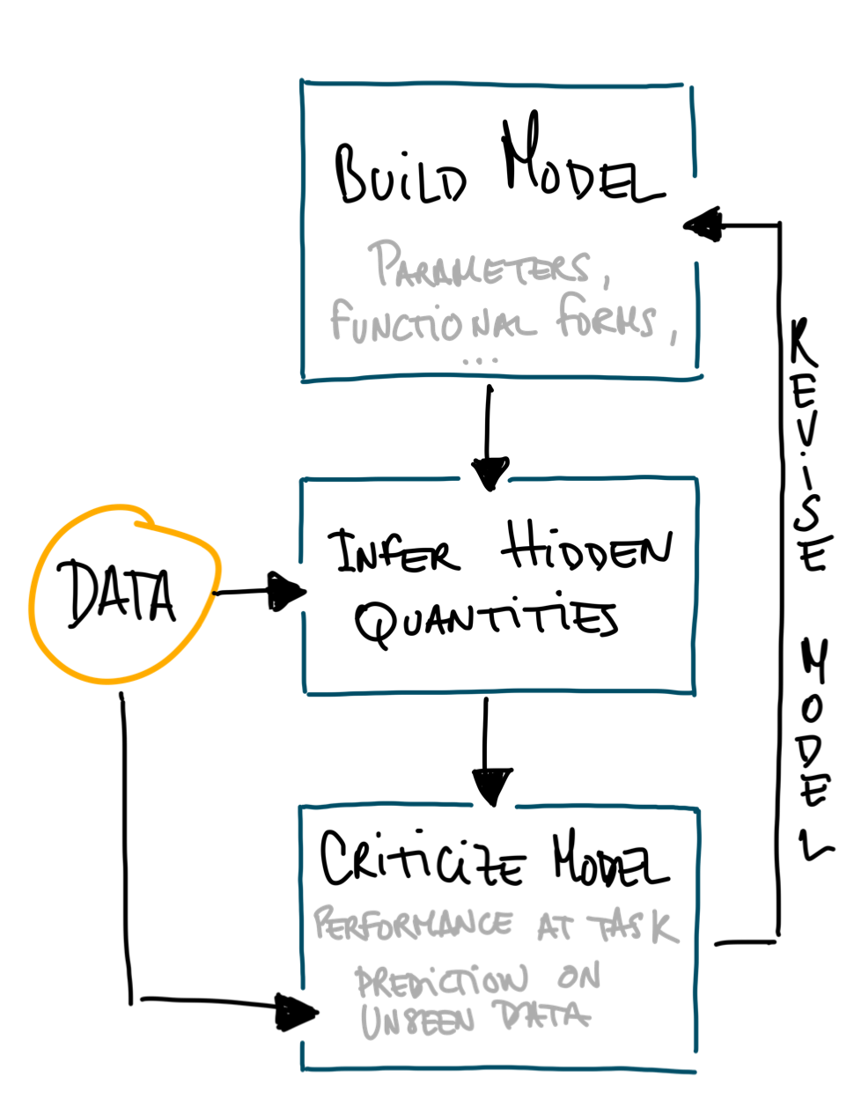
All models are wrong but some are useful
In practice model building is part art-form and part science.
To make a model you have to make simplifying assumptions. The art is in making simplifying assumptions that preserve key features of reality, thus enabling us to learn something from the model and/or use it for something.
Box’s loop – A modern interpretation of Box’s perspective (1976) on the process of model building – inference – validation – revision.
Notes:
Pretty much whenever we design an experiment, or analyse data, and certainly if we make any kind of hypothesis, then implicitly or otherwise, we are building a model. In many situations it is beneficial to make this model as explicit as possible. In doing so it forces us to state our assumptions and enables us to test to what degree our assumptions approximate reality. Often model building will enable us to go much further than this though. If we are able to model our system of interest, then it enables us to make predictions and/or draw other conclusions from our data. If our model fails to match observation it can guide the future direction of our research. This process can be summarised by what is sometimes referred to as Box's loop.
In practice, all models involve making false assumptions, and are, at some level wrong. Nevertheless, despite being wrong, they can help us make sense of the world in ways we would not be able to otherwise. As we move into an era of high-throughput experiments, large scale sequencing efforts, multiomics analysis...our ability to build a model of this data is quickly becoming central to what we can learn from these large scale efforts. Models are also playing an ever more critical role in the design of these experiments.
UPDATING OUR BELIEFS

Slide 16
Mains

Slide 17
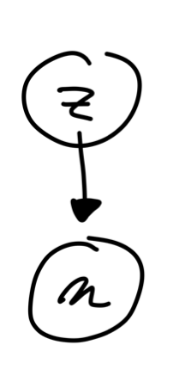

Bayes' Theorem Rule
and how to update beliefs based on new evidence
Consider observations and parameters and a generative story
The complete system is described by but notice:
So
Prior Probability: it represents our initial beliefs or knowledge about the parameters before observing any data.
Notes:
So far we have talked about modelling a system but how do we learn from observations? This is where Bayes' rule comes in

Slide 18
Bayes' Theorem Rule
and how to update beliefs based on new evidence
Consider observations and parameters and a generative story
The complete system is described by but notice:
So
Prior Probability: it represents our initial beliefs or knowledge about the parameters before observing any data.
Likelihood: it quantifies how likely the observed data is under different parameter values
Notes:
So far we have talked about modelling a system but how do we learn from observations? This is where Bayes' rule comes in

Slide 19
Bayes' Theorem Rule
and how to update beliefs based on new evidence
Consider observations and parameters and a generative story
The complete system is described by but notice:
So
Prior Probability: it represents our initial beliefs or knowledge about the parameters before observing any data.
Posterior Probability: it represents our updated beliefs about the parameters after considering the observed data.
Likelihood: it quantifies how likely the observed data is under different parameter values
Notes:
So far we have talked about modelling a system but how do we learn from observations? This is where Bayes' rule comes in

Slide 20

Example: Modelling a possibly biased coin

Slide 21
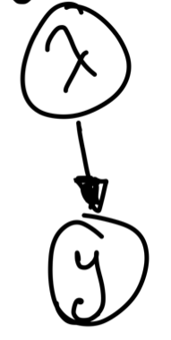
Example: Modelling a possibly biased coin
Model assumptions & parameters
Setting: We observe the coin being thrown in the air times and for each instance we record if the coin lands with heads facing up, or tails.
To model this system we make some assumptions. The key ones are:
1. The result of each throw is statistically independent.
2. The conditions are not changing from one throw to the next.
In other words, we assume the throws are "independent and identically distributed" (iid).
The simplest model has one parameter, the latent fairness of the coin , such that for each throw , where if tails and if heads, we have

Slide 22
Example: Modelling a possibly biased coin – Q1 likelihood of sequence
Q1.
What is the likelihood of the sequence where if tails and if heads?

Slide 23
Example: Modelling a possibly biased coin – Q1 likelihood of sequence
Q1.
What is the likelihood of the sequence where if tails and if heads?
If the probability of tails is then the probability of heads is .
This means the probability of observing the sequence is
which is simply
where is the number of tails.

Slide 24
Example: Modelling a possibly biased coin – Q2 likelihood of sequence with m tails
Q2.
What is the probability of getting exactly tails in throws?

Slide 25
Example: Modelling a possibly biased coin – Q2 likelihood of sequence with m tails
Q2.
What is the probability of getting exactly tails in throws?
In Q1 we are considering a fixed sequence of events but to answer Q2 we need to account for the fact that there are multiple ways of getting tails in a sequence of throws.
The answer is given by the Binomial distribution:

Slide 26
Example: Modelling a possibly biased coin – Q3 maximum likelihood
Q3.
What is the maximum likelihood solution for ?

Slide 27
Example: Modelling a possibly biased coin – Q3 maximum likelihood
Q3.
What is the maximum likelihood solution for ?
We want to find the maximum of the likelihood function found in Q1 or Q2.
One way to do this is to first take the log of the expression, then differentiate w.r.t 𝜆, then find when the resulting expression vanishes. This gives
This is great! This is what one might have guessed before doing any algebra. The probability of getting a tails is given by the empirical frequency of tails in the dataset 𝐷.

Slide 28
Example: Modelling a possibly biased coin – Q4 what is your model like after 1 throw?
Q4.
Suppose the first flip is tails. What is the probability that the next flip will be tails?

Slide 29
Example: Modelling a possibly biased coin – Q4 what is your model like after 1 throw?
Q4.
Suppose the first flip is tails. What is the probability that the next flip will be tails?
Even though we assume the data is iid, based on our maximum likelihood estimation of 𝜆,
if we observe one tails then 𝑚=𝑛=1, so the probability that the next throw lands with tails facing up is exactly 1!
What went wrong?

Slide 30
Attempt 2: Modelling a possibly biased coin from a Bayesian perspective
The problem is that the above argument does not reflect our beliefs about the coin.
Consider now what happens if you take a Bayesian approach with a prior for
For example, a Beta distribution:
A very flexible, and convenient (we will explain why in a second) function for the prior.

Slide 31
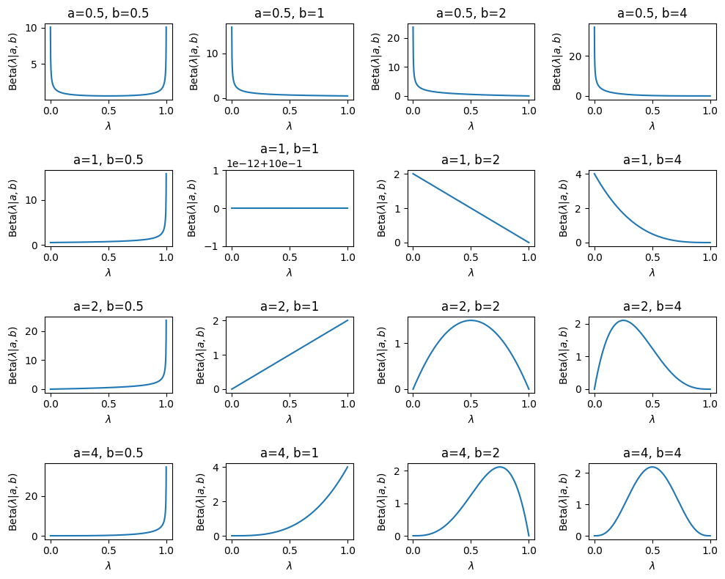
Notes:
We might think the $\lambda$ is probably close to 0.5 but also want to allow for the possibility of bias. In which case we might want to choose $a = b = 4$, for instance.
* We might stongly suspect the coin is very biased but not sure if it is biased towards heads or tails. In which case we might go for something funky like $a = b = 0.5$
* We might think it's biased towards tails but not sure how much (a=4, b=2)
* We might have absolutely no idea what to expect (a = b = 1).

Slide 32
Attempt 2: Modelling a possibly biased coin from a Bayesian perspective
So now we can try to model this system again, but this time using a Bayesian approach.
Computing the posterior:
Bayes rule tells us that
with

Slide 33
Attempt 2: Modelling a possibly biased coin from a Bayesian perspective
So now we can try to model this system again, but this time using a Bayesian approach.
Computing the posterior:
Bayes rule tells us that
with
and hence

Slide 34
Attempt 2: Modelling a possibly biased coin from a Bayesian perspective
Computing the probability of tails next flip:
In Bayesian statistics, this is the probability of flipping tails conditional on the observed data, which we obtain by marginalising over . We call this the posterior predictive.

Slide 35
Attempt 2: Modelling a possibly biased coin from a Bayesian perspective
Computing the probability of tails next flip:
In Bayesian statistics, this is the probability of flipping tails conditional on the observed data, which we obtain by marginalising over . We call this the posterior predictive.
In other words
And we see that parameters a and b play the role of pseudo counts!
posterior
Expectation value of

Slide 36
Attempt 2: Modelling a possibly biased coin from a Bayesian perspective
So we see that the parameters a and b play the role of pseudo counts!
More informative priors

Slide 37
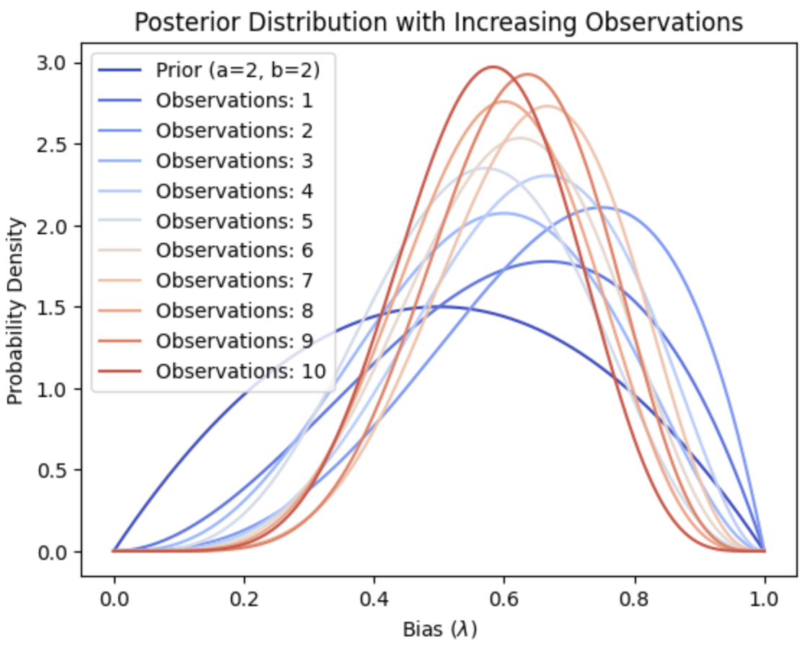
Updating beliefs upon new observations

Slide 38
Desserts

Slide 39
Two notes on inference – 1. Conjugate priors
“our model”
prior belief
Bayes’ rule:
How the data determines your model

Slide 40
Two notes on inference – 1. Conjugate priors
Bayes’ rule:
In the coin flipping example:
Prior:
Posterior:
Whenever the prior distribution is of the same family as the posterior, it is called a conjugate prior for the likelihood function.
We know the functional form of the posterior!

Slide 41
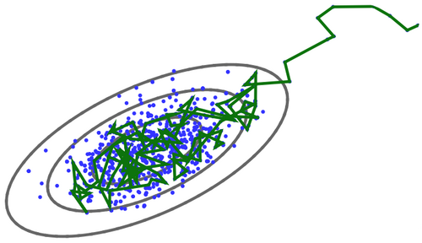
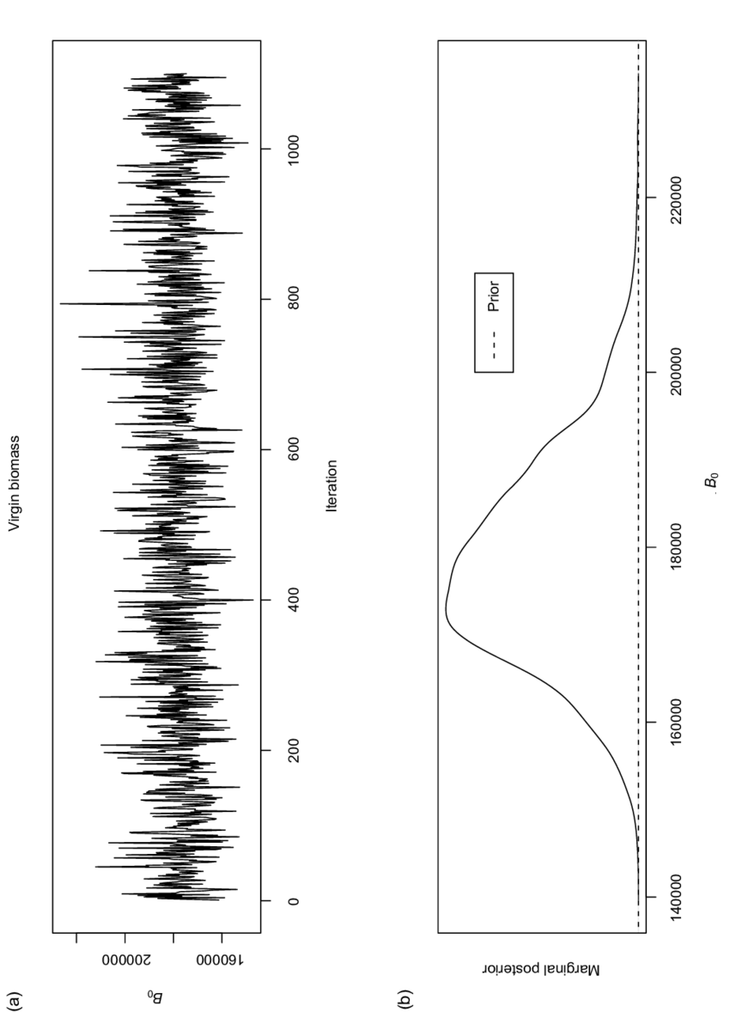
Two notes on inference – 2. Numerical approaches
MCMC: exploring the posterior with a Markov chain
1. The algorithm starts with an initial guess for the parameter.
2. It then proposes a new value for the parameter, based on a proposal distribution.
3. It attributes a probability based on Bayes’ rule.
4. In the large sample limit it converges to the posterior.
Video?
Trace plot
Sampled posterior

Slide 42
Two notes on inference – 2. Numerical approaches
Variational Inference: approximating the posterior with a guide distribution
1. Choose a guide distribution
2. Find the best parameters that minimise the distance (KL divergence) between and the posterior
3. In practice, minimising the KL divergence is done via maximising the Evidence Lower Bound (ELBO)

Slide 43
Two notes on inference – 2. Numerical approaches
Variational Inference: approximating the posterior with a guide distribution
1. Choose a guide distribution
2. Find the best parameters that minimise the distance (KL divergence) between and the posterior
3. In practice, minimising the KL divergence is done via maximising the Evidence Lower Bound (ELBO)
Advantages of MCMC Vs VI – Accuracy vs. Speed Trade-off

Slide 44
Hierarchical modelling
Bayesian modelling really shines when we consider models with a rich structure of dependencies between variables.
Hierarchical modelling can be viewed as an information sharing mechanism between subgroups that share common properties. Hierarchical modelling can be used as a way to learn those common features, while also providing the freedom for each group to differ.
Hierarchical modelling can also be a very effective way of avoiding certain types of overfitting, since hierarchical structure can be thought of as learning an informative prior for each subgroup.

Slide 45
Bayesian experimental design
Bayesian modelling can be used to design experiments which reduce the number of tests one has to make to make in order to reach a conclusion. This is intimately related to topics such as active learning.
“What is the next data point that would increase my information gain about the posterior?”
?
Expected information gain
This is a very active area of research with the potential to transform protein design and possibly many other areas of research.

Slide 46
MENU
Starters
Bayesian models as generative stories
DAGs
Box’s Loop
Mains
Bayes' rule
A working exercise: coin flipping
Informative Vs uninformative priors
Dessert
Notes on inference: conjugate priors & numerical approaches
Hierarchical models
Bayesian Experimental Design

Slide 47
A very short introduction to Bayesian Model Building
Mafalda Dias & Jonathan Frazer

Slide 48
Possible extra slides
If following those last few steps was a struggle, fear not. There are a number of important concepts packed into the last few expressions. Three points we will now go through in more detail
1. How on Earth did the posterior $p(\lambda | D)$ simplify to the Beta distribution
2. What is the reasoning behind the expression for $p({\rm tails \ next \ flip} |D)$ and how does this relate to the maximum likelihood estimate we computed in the first attempts at this problem.
3. What are the limiting cases of $\mathbb{E}(\lambda|D)$ and how does this relate to the maximum likelihood estimate we computed in the first attempts at this problem.
We will address these questions in reverse order.
TODO: Address these questions

